Slide 1












Telecom Customer Churn
DATA ANALYSIS
Presented By:
ANJAN PAUL
Churn Analysis For Customers
Page- 1
Notes:
intro

Slide 2





Presentation Objective
The Objective of this project is to find out what causes customers to leave (churn) in a telecom company by analyzing and visualizing the data. Using tools like MySQL, Power BI, the project aims to create clear Insights in SQL queries and dashboards for Churn, Revenue, and Services. These insights will help the company take smart actions to keep customers happy and reduce churn.
Page- 2
Notes:
Objective

Slide 3






Problem Statement
The Challenge: Why Customers Leave
Customer Churn (people leaving services) is the biggest threat to a Company’s revenue.
It costs much more money to find a new customer than it does to keep an existing one.
Every customer who leaves takes their monthly payment with them, directly hurting a company’s profit.
Who is Leaving (Which Customer Groups Churn most)?
What services/ contracts are related to Churn (is it a service issue or a pricing issue)?
What action you can take (how would you use these insights to keep more customers)?
Page- 3
Notes:
Problem statement

Slide 4





Project Requirements Tools
Kaggle: Data Download Using API
MySQL Workbench: SQL Database
Power Query Editor: Power BI
Power BI Desktop: Dashboard Creation
[Database/Management] Import the data into the proper Database structure. Added missing Customer’s Date of Birth(Synthetic).
[Visualization] Connected the Database to build 3 dashboards (churn, revenue, service)turned data into easy to understand business insights.
Page- 4
Notes:
tools

Slide 5




Know Your Columns
Unique Identifier:
Customer ID
Demographics:
Gender, Senior Citizen, Partner, Dependents, DOB
Phone Service, Multiple Lines, Internet, Online Security, Online Backup, Device Protection, Tech Support, Streaming TV, Streaming Movies, Paperless Billing
Services:
Financials:
Tenure, Contract, Payment Method, Monthly Charges, Total Charges
Customer Details: Help us find which customer groups are most likely to leave/churn.
Service: Identifies if problems are linked to the quality or type of services used.
Contract and Money: Identifies how customers pay & which financial factors drive them to leave.
Dependent Variable:
Churn
Page- 5
Notes:
Columns details

Slide 6

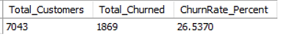
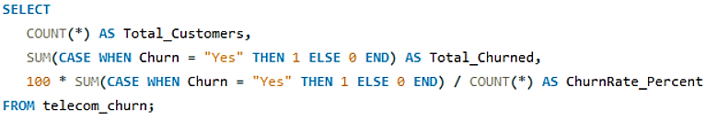
Business Problems
To calculate the overall churn rate of the entire customer base
Purposes: To measure the overall customer base for the project. This query calculates the percentage of all customers who left the company.
Insights: Almost 26.54% customers are leaving the company. This is the main problem, so we must focus on reducing it.
Page- 6
Notes:
Business problems 1

Slide 7
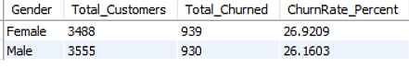
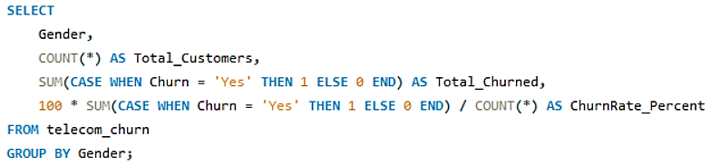
Business Problems
Compare churn rates between gender
Purposes: To find out if customer churn is higher for one gender compare to the other.
Insights: The problem of high churn affects male and female customers almost equally, so we should focus our efforts on other factors.
Page- 7
Notes:
Business problems 2

Slide 8
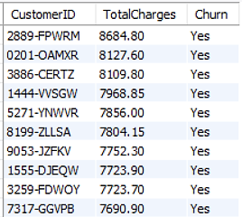
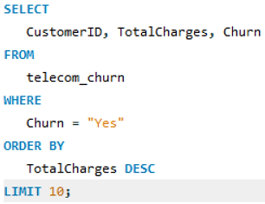
Business Problems
Identify the customers who have paid the highest total charges but still churned
Purposes: To find the customers who had the highest total charges but still decided to leave the company.
Insights: We are losing customers who pay the most(negative impact on our revenue), so we must focus on retaining the high spending customers.
Page- 8
Notes:
Business problems 3

Slide 9
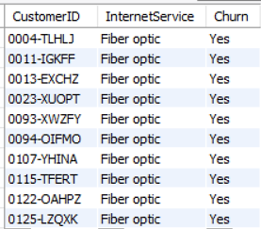
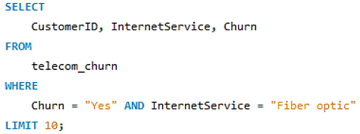
Business Problems
Identify which churned customers used fiber optic in Internet Service
Purposes: To check how many churned customers were using Fiber Optic internet service. This helps us see if a specific product is causing customer loss.
Insights: We need to investigate the Fiber Optic service. problems could include high price or poor customer support.
Page- 9
Notes:
Business problems 4

Slide 10
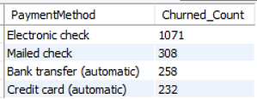
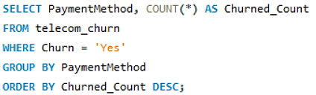
Business Problems
Count of churned customers by payment method
Purposes: To find out which payment method is used most often by customers who churn. This identifies if the payment process itself is a cause of dissatisfaction.
Insights: The electronic check payment method is the biggest churn risk and needs to be investigate. We should encourage customers to switch to automatic payment options.
Page- 10
Notes:
Business problems 5

Slide 11
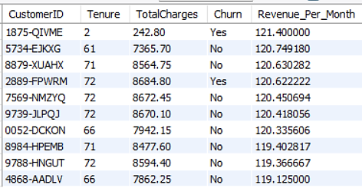
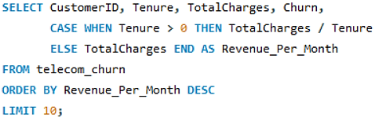
Business Problems
Top 10 customers by revenue per month (Life time value)
Purposes: To show which customers have given the money on average each month over their time with the company.
Insights: We must identify our highest-paying customers. A small number of customers often make a large share of revenue, so protect them at first.
Page- 11
Notes:
Business problems 6

Slide 12
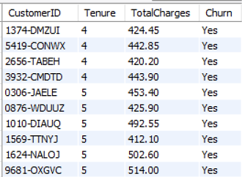
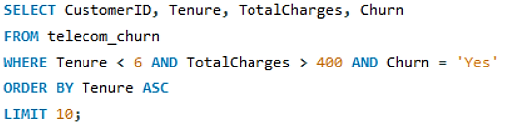
Business Problems
High value and short tenure customers who left early
Purposes: Find customers who paid a lot of money but churned within their first 6 months.
Insights: Identify customers who gave a lot of money in a short time but then left (top retention priority). Maybe this is a sign of poor initial experience or technical problems.
Page- 12
Notes:
Business problems 7

Slide 13
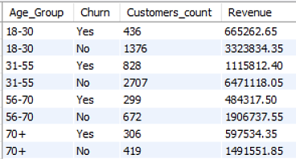
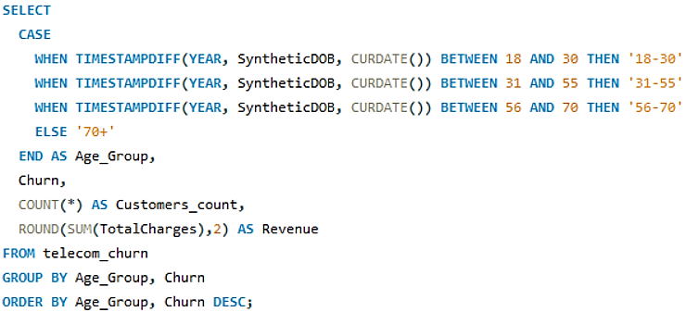
Business Problems
churn vs retained revenue & customer counts inside each age group
Purposes: See how many customers in each age group leave the company and how much revenue those departures represent.
Insights: Show if an age group has high churn and high lost revenue, it’s the top priority for retention. When a group is large and spends a lot, it makes their churn financially painful.
Page- 13
Notes:
Business problems 8

Slide 14
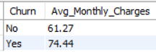
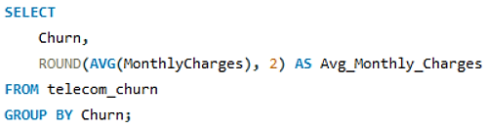
Business Problems
Average monthly charges for churned and retained customers
Purposes:. To compare the average monthly charge of customers who left vs customers who stayed.
Insights: Identify customers who left were paying significantly more on average than customers who stayed.
Page- 14
Notes:
Business problems 9

Slide 15
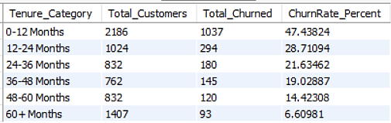
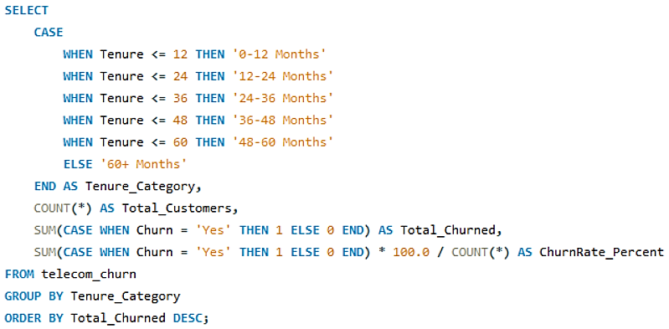
Business Problems
Total churn and churn rate by Tenure category
Purposes: To group customers by how long they have been with the company (Tenure) and find the churn rate for each group. This shows when we are most likely to lose a customer.
Insights: The highest churn is in the short term(0-12 Months). We have a major problem in keeping new customers. So we must design and implement a retention program specially for short term customers.
Page- 15
Notes:
Business problems 10

Slide 16
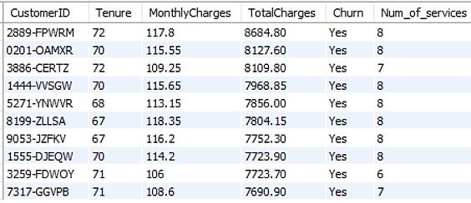
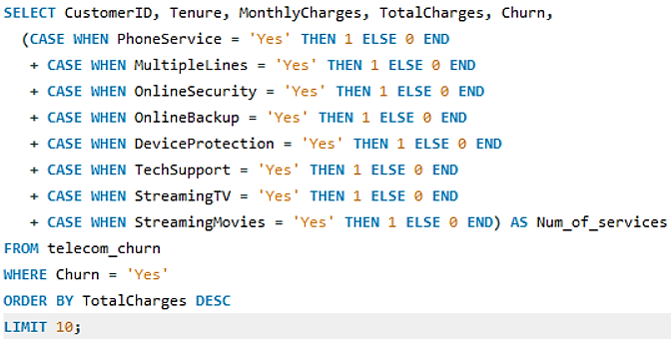
Business Problems
Customers who bought many services but still churned
Purposes:. To find customers who purchased a high number of extra services but still decided to churn(failure in service delivery).
Insights: Identify customers who are losing interest in the best services because of the higher their expectation for quality and support. We must review the quality and responsiveness of our services.
Page- 16
Notes:
Business problems 11

Slide 17
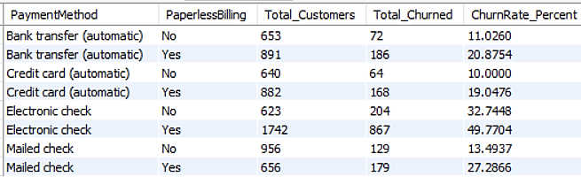
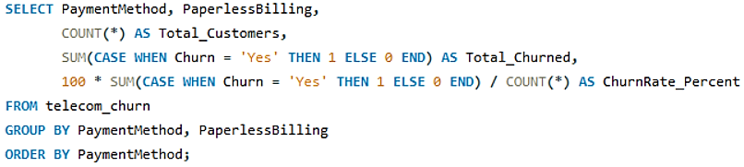
Business Problems
Total churn and churn rate by Payment method & paperless billing
Purposes: To identify the risk created by combining the electronic check payment method with paperless billing.
Insights: The digital process involving electronic payments and billing is severely broken. We must immediately investigate and fix the system failures or confusing process steps related to Electronic Check payments and digital billing.
Page- 17
Notes:
Business problems 12

Slide 18
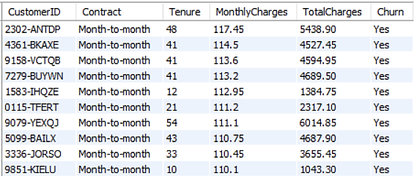
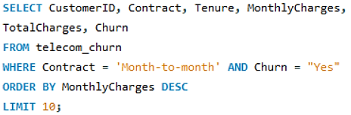
Business Problems
Month-to-month customers with high monthly bills who left
Purposes:. Find high-paying customers on month-to-month plans who still churn (expensive losses)
Insights: To show which month-to-month customers were paying a lot but still left. Offer targeted incentives to these customers and focus on larger plans.
Page- 18
Notes:
Business problems 13

Slide 19


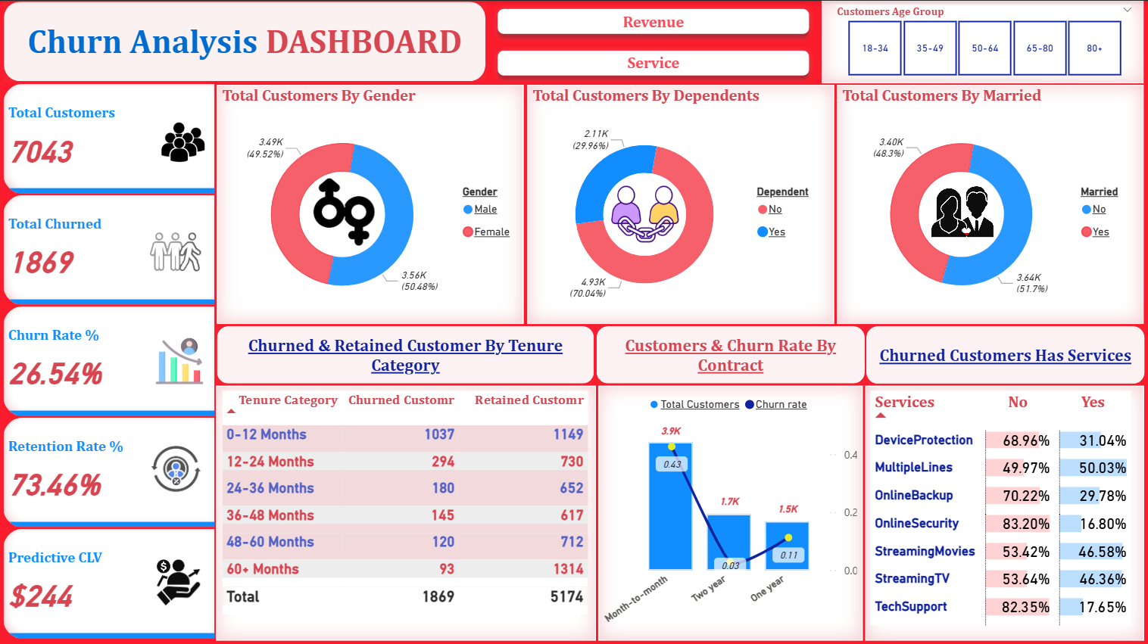
Dashboard Churn:
Page- 19
Notes:
Dashboard(Churn)

Slide 20

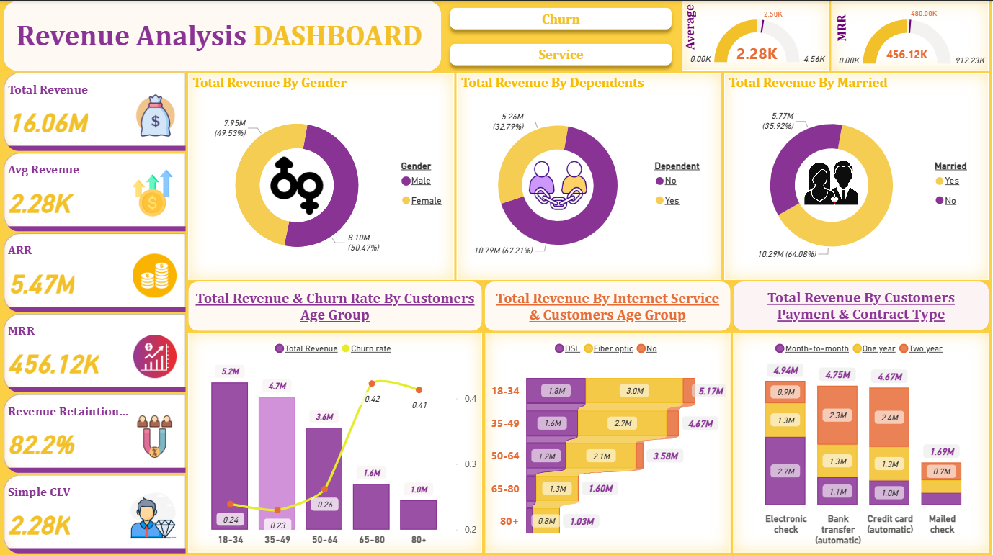
Dashboard Revenue:
Page- 20
Notes:
Dashboard(Revenue)

Slide 21

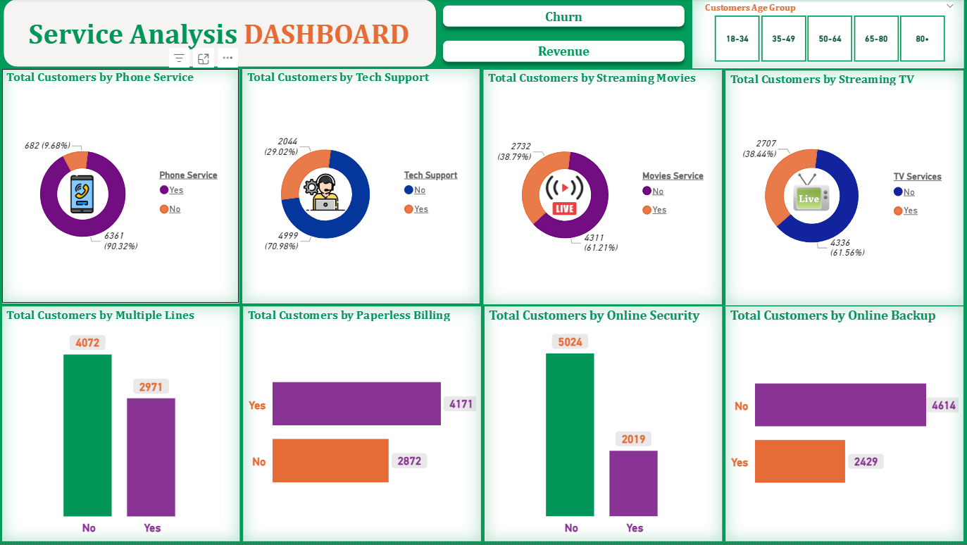
Dashboard Service:
Page- 21
Notes:
Dashboard(Churn)

Slide 22

Results & Insights
Service Quality: The customers who pay the most for premium services are the most unhappy & likely to leave.
New Customer Failure: We are failing to keep new customers. The first year of service is the highest risk period.
Customer Protect: Show customers have given the most revenue over their lifetime.
Age Group Focus: Some age groups both leave more & cost more in lost revenue.
Contract Commitment: The risky customer profile pays high prices on an easy month-to-month contract
Page- 22
Notes:
Results/insights

Slide 23
Challenges Faced
The raw data had null values, which had to be carefully managed. Missing the customer’s Date of birth, so create the Synthetic data within MYSQL to perform the valuable age group analysis.
Creating useful variables (age groups, tenure category, service counts) needs careful rules. Define clear, business-driven group rules and verify with samples before aggregating.
It analyses a huge number of factors. The challenge was to translate the technical results(MYSQL)into short, easy-to-understand that can be used to reduce churn.
Page- 23
Notes:
Challenges faced

Slide 24


Conclusion
This project successfully turned raw customer data into a clear strategy for reducing customer loss. This analysis shows that major problem with premium services are making the most valuable clients unhappy. By fixing the core service & process failures, we secure revenue & ensure better long-term customer loyalty. The data insights provide the roadmap needed for successful retention efforts.
anjan-paul-391998277/
anjan-iixi
Page- 24
Notes:
Conclusion

